Slide 1
WEATHER APPLICATION APP
PRESENTATION: AMUKELANI NHLEGETHWA- ST10446794
PURPOSE OF THE APP: Initially this application is a weather app that is perfectly designed to provide users with a detailed and on point weather forecast information for a week. It comes with features such as
Average weather display
The main objective of the main screen is to portray the average minimum & maximum temperature for the week, and also offers the users a brief of the weather trends of the upcoming days of the week will likely unfold.
A well briefed weather forecast view
The users can view detailed weather forecast from Monday until Sunday, adding on with the minimum and maximum values of the forecast.
F

Slide 2
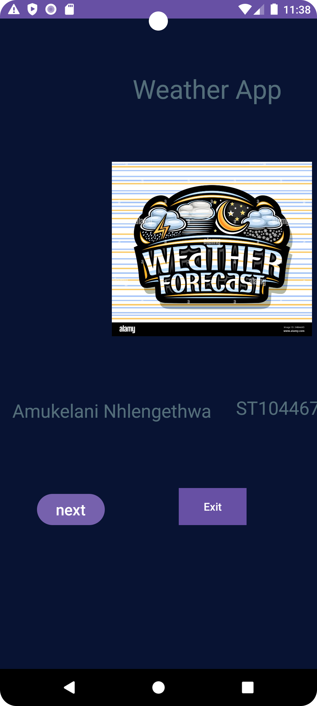
THIS IS THE FIRST SCREEN IN WHICH IT IS CLASSIFIED AS SPLASH SCREEN IT ALLOWS THE USER TO GO TO THE MAIN SCREEN WHICH ELOBORATES FURTHER
WELLCOME TO THE WEATHER APP: DEVELOPED BY AMUKELANI NHLENGETHA ST10446794

Slide 3
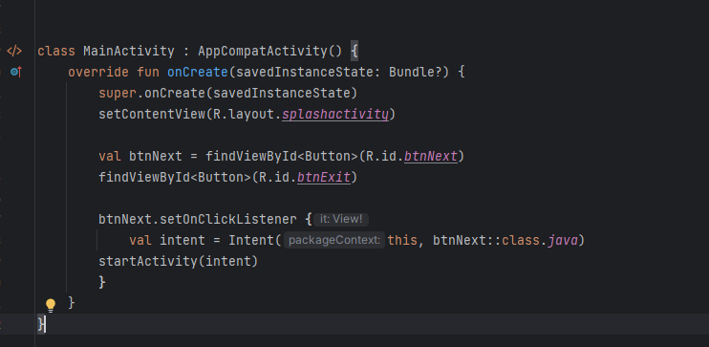
THIS IS THE SPLASH SCREEN CODE WHICH PORTRAYS THE BUTTONS, AND TEXTVIEWS USED SO THAT USER CAN SELECT IF THE WANT TO GO THE MAINSCREEN TO SEE THE WEATHER INFORMATION OR EXIT OUT OF THE WEATHER APPLICATION

Slide 4
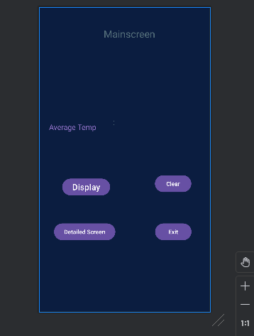
THIS IS THE MAINSCREEN OF THE APPLIOCATION WHICH WILL INDICAE THE AVERAGE TEMPERATURE OF THE WEEK DEPENDING ON USERS OPTION WEATHER ITS MAXIMUM VALUE OR MINIMUM VALUE

Slide 5
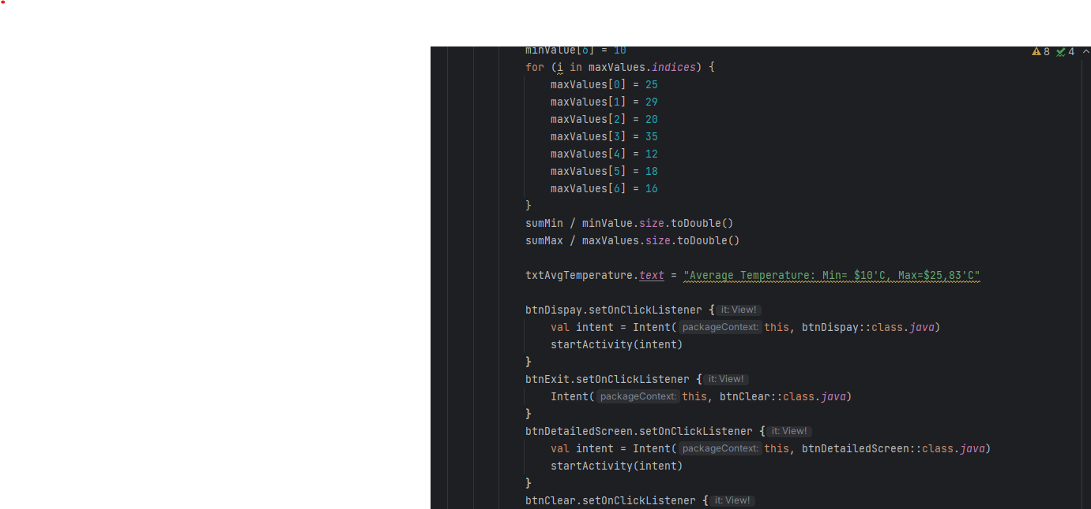
THIS IS THE CODE THAT SHOWS THE ARRAYS BEING USED INCLUDING THE TYPE OF LOOP THAT THE APPLICATION USES

Slide 6
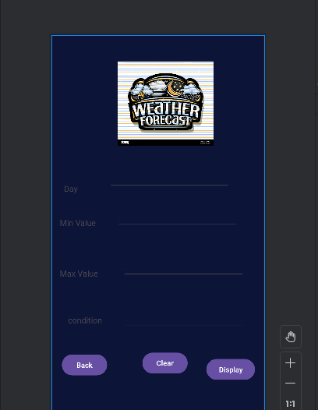
THE MOST INTRESTING SCREEN OF THE APP WHICH GIVES YOU THE ALL ROUNDED INFORMATION FOR THIS APPLICATION PRECISELY ELABORATING THE DAY,MINIMUM VALUE, MAXIMUM VALUE, LASTLY THE CONDITION OF THE WEATHER.THE OBJECTIVE OF THIS SCREEN IS TO MAKE THE USER KNOW HOW THE WETHAER WILL BE ON A SPECIFIC DAY.

Slide 7
WELLCOME TO THE WEATHER APPS EMULATOR HOPE YOU ENJOY…

